Slide 1

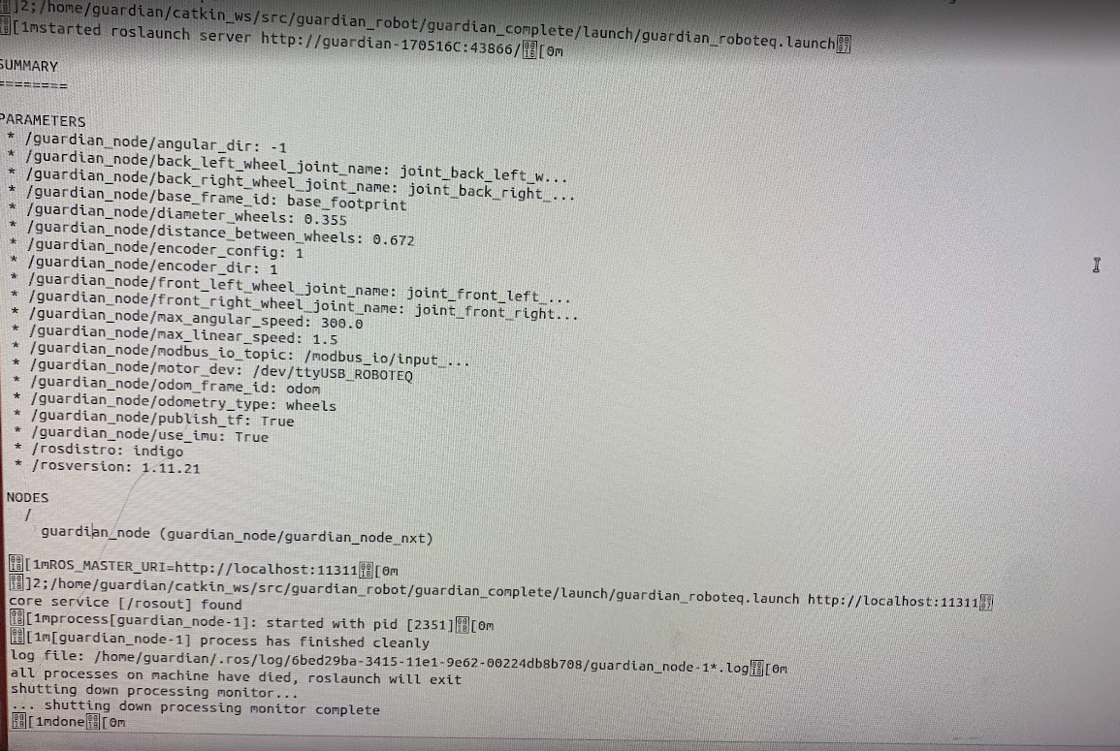
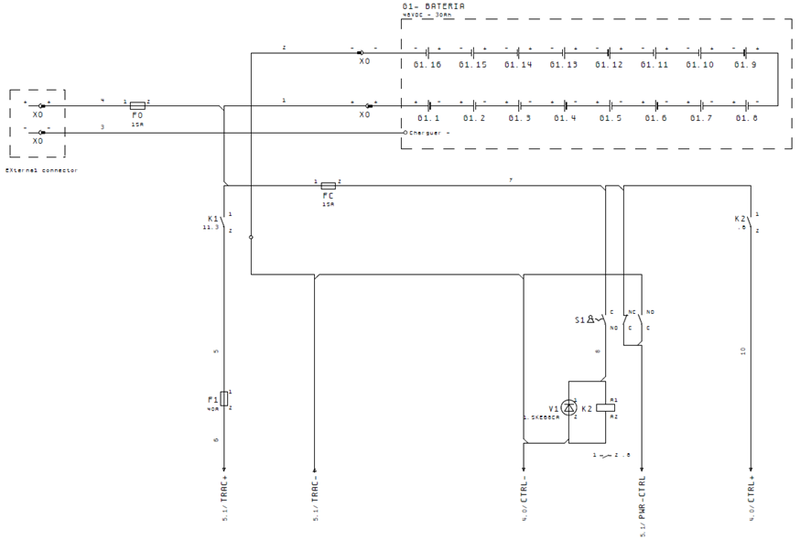
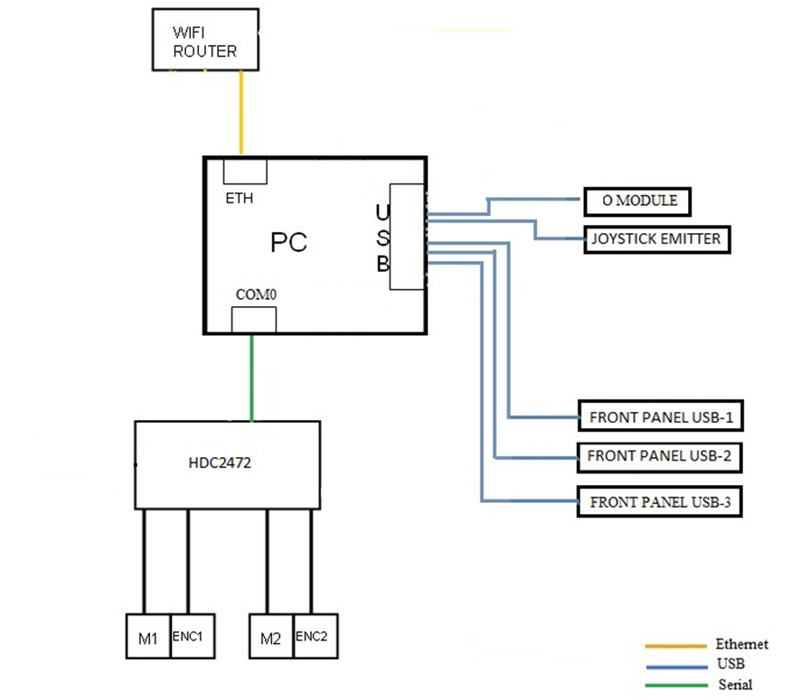
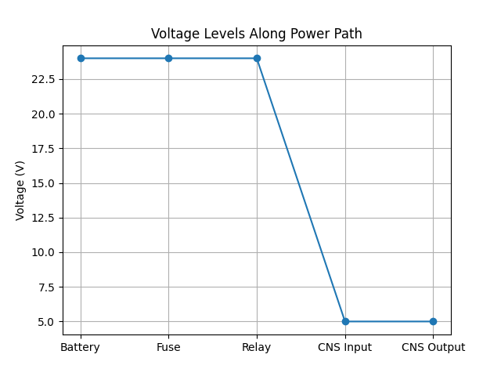
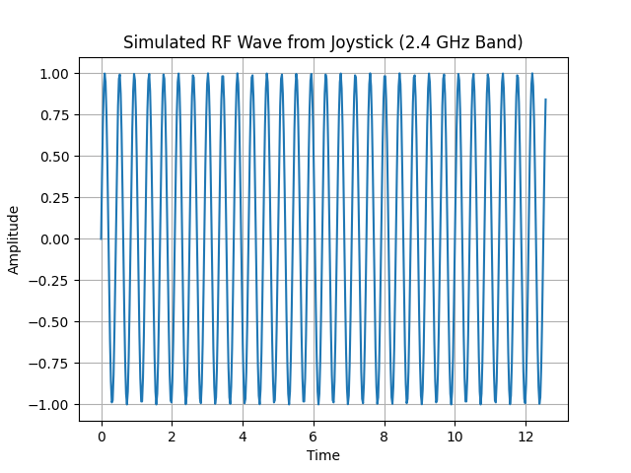
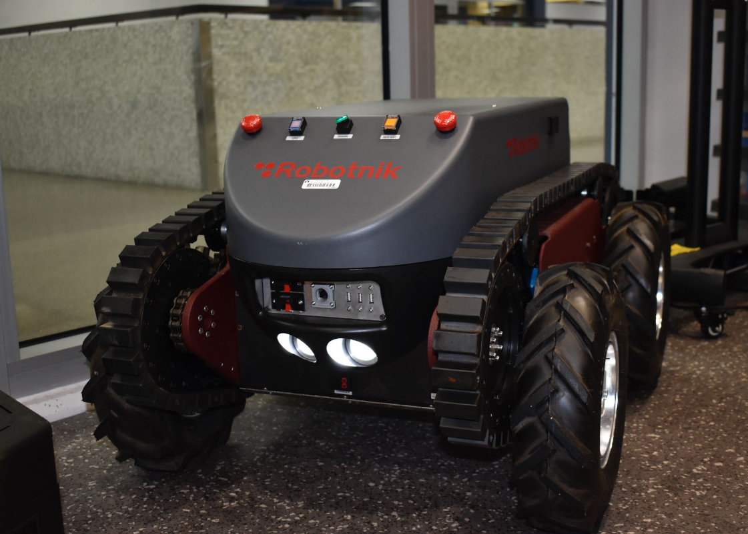
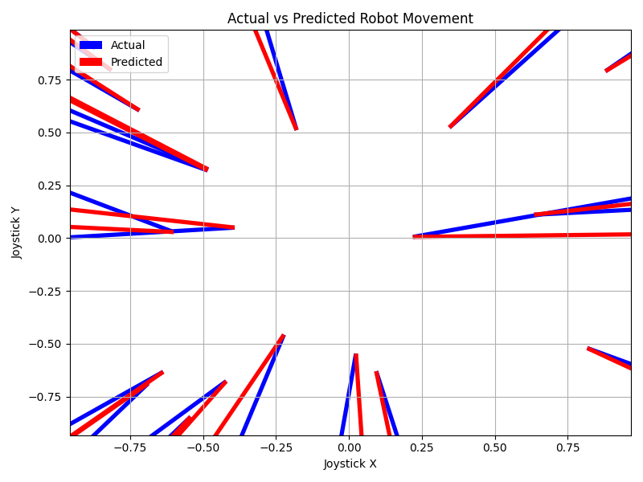
Embedded Electrical Integration for Startup, Teleoperation, and Future Autonomy in Unmanned Ground Vehicles (UGVs)
Jason Souter, Sarah Rosales, Paulina Olaiz, and Fred Mawudzro, M.S.
Miami Dade College, North Campus, Miami, FL
Introduction
Results
Discussion
Conclusion
Autonomous Ground Vehicles (AGVs) are robotic platforms designed to operate with limited human intervention. This project focuses on studying the embedded and electrical systems integration of the Robotnik Guardian, an Unmanned Ground Vehicle (UGV) intended for autonomous applications in search and rescue and combat search and rescue scenarios. This project represents a study of embedded system diagnostic skills, an enhanced system-level understanding of control systems, and advances the overall readiness of the platform for future expansion into autonomous applications.
The results from all the methods mentioned were successful due to the knowledge gained about the tank. The tank will not move unless there’s a monitor plugged in to the CPU. A short-term fix is plugging in a HDMI 4K UHD, Virtual Display Dummy (Headless Ghost Adapter), manipulating the Guardian into thinking there is a monitor plugged in. Although this may have solved the issue for now, in the long run, this is not a valid solution. The overall goal, however, was a success.
The work that was done ensured the knowledge of the functionality of the Robotnik Guardian. In the future, there are opportunities to proceed solving the issue with the Guardian robot.
By bridging electrical diagnostics with robotic software, this work ensured reliable system startup, validated safety-critical pathways, and enabled remote motion control. These efforts directly contribute to the robot’s readiness for mentioned goals.
References
Guardian Robotics. (n.d.). Guardian Robot technical manual [Unpublished internal document]. Provided by former employee, June 2025.
Robotnik Automation. (n.d.) Robot Guardian. https://pdf.directindustry.com/pdf/robotnik/mobile-robot-guardian/177504-659930.html
Song, Q., & Zhao, Q. (2024). Recent Advances in Robotics and Intelligent Robots Applications. Applied Sciences (2076-3417), 14(10), 4279. https://doi.org/10.3390/app14104279
Open Source Robotics Foundation. (n.d.). Robot Operating System (ROS). Retrieved August 7, 2025, from https://www.ros.org/
Robotnik Automation. (n.d.). Robotnik: Mobile robotics solutions. Retrieved August 7, 2025, from https://robotnik.eu/
Robotnik Automation. (n.d.). RobotnikAutomation · GitHub. Retrieved August 7, 2025, from https://github.com/RobotnikAutomation
Open Robotics. (n.d.). Gazebo: Robot simulation made easy. Retrieved August 7, 2025, from https://gazebosim.org/home
Purpose
This study aims to understand and improve the Guardian’s current functionality by establishing safe startup behavior and implementing reliable motion control, understand the robot’s supervised electrical architecture, validating safety-critical components such as fuses and relays, and deploying a Robot Operating System (ROS)-based motion control system to ensure consistent startup and teleoperation.
Goals
Figure 1 - Captured data from CPU
Figure 2 - Power Supply Diagram (Robotnik Guardian “Power and Control Manual”)
Figure 3 - Communication Diagram (Robotnik Guardian “Power and Control Manual”)
Headless Boot Startup | Autonomous Navigation Planning
Sensor Integration & Obstacle Detection | AI Integration
Methodology
Power Pathway Validation:
Traces and documented the startup logic and supervised supply routing. The LED status indicators were observed on the HDC2472 to confirm system health.
Electrical Systems Diagnosis:
Conducted continuity testing of safety-critical components (relays, fuses, wiring paths) and verified voltage paths from battery to CNS, relays, and motion control board.
Real-time Data Logging:
Conducted data logging on CPU for communication with notepad. This is used to capture what is being executed.
Figure 4 – Voltage Levels Along Power Path
Visual graph of level of voltage and pathway.
Figure 5 – Visualized simulation of signals from controller
Acknowledgements
The original research summarized in the following was supported, in part, by U.S. Department of Education grant awards: P120A200007 (STEM AISLE), P031C210035 (STEM PACTS), P031C210028 (STEM SMART) and P031A220012 (Engine of Progress). Any opinions, findings, conclusions, or recommendations expressed in this material are those of the authors and do not necessarily reflect the views of the funding agency. The author would like to give a sincere thank you to Professor Mawudzro, Miami Dade College, North Campus and the School of Engineering & Technology (ENTEC), and the AI & Robotics Club members for their continuous support and guidance.
Figure 6 – Visualized prediction for future autonomy

